Slide 1

FIFA Distributed Game
FUNCTIONAL PROGRAMMING IN
CONCURRENT AND DISTRIBUTED SYSTEMS
Instructors: Dr. Yehuda Ben-Shimol, Mr. David Leon
By: Yuval Assayag, Moshe Dahan

Slide 2
Outline
Project Description
Project Architecture
Server Crash Handling
Main Components - FSM
Statistics
Snapshots
Project Overview
Links

Slide 3
Project Description

Slide 4
Distributed design!
100%
Distributed FIFA Game

Slide 5

Remote Control Feature
Users Remote Control Enabled!
Controlled Player

Slide 6
Project Description
Distributed FIFA game contains:
Two teams.
Each team contains 10 players 1 goalie.
Single referee.
Each team act upon different strategis.
The referee is watching the ball from a safe distance.

Slide 7
Teams Strategies
Team one strategy is to divide into two sub groups - defenders and attackers.
Team two strategy is to work in a random manner around the field.
Each Goalie defends his team net.

Slide 8
Controlled Player
The user can control one player using the mouse with the following abilities:
1. Moving across the entire soccer field.
2. Kicking the ball.
3. Snatching the ball from another player.
The controlled player has special color in order to be detected easily.

Slide 9
When The Game Is Over?
The game is over when one of the teams gains 3 points.
How does a team gain a point?
By scoring 3 Goals to the opponent team.
Reasoning:
Because we have limited time for the presentation we can’t afford a 90 minutes game.

Slide 10
Project Architecture

Slide 11
Project Goal
Our goal in this project was to create a distributed FIFA game using Erlang language and Functional Programming knowledge we have gained along the course.

Slide 12
Top Design
Global ETS
Wx Server
(gen_server)
Monitor A
(gen_server)
Monitor B
(gen_server)
Monitor C
(gen_server)
Monitor C
(gen_server)
ETS
ETS
ETS
ETS

Slide 13
Top Design Explanation
In this project there are 5 servers (gen_server). The communication between the servers is asynchronous and the manager server is the WX sever. The rest of the servers are implemented in the same way and have the same functionalities. We wanted to achieve a game that would be sustainable to crashes of each of the servers described above (excluding the WX server).

Slide 14
WX Server
This is the server which manage all the game these are it main responsibilities:
Initiation and monitor of the 4 regular servers
Rearrange all servers’ responsibilities in case of a crash.
Manages the game’s graphics.
Posses the statistic of the entire game (ball possessions, points, etc).
Refreshing the locations of all the players.
Acting upon the mouse movement using WX functions (wx_object).
Announce when the game is over.

Slide 15
Regular Server
Each server responsible for a certain slice of the screen - depending on how many servers are running at the moment.
In initialization time there are 4 regular servers running each of them responsible on a vertical rectangle which represents a quarter of the soccer field.
Each screen monitors the objects within its boundaries.

Slide 16
Design overview
Simulation is based on Erlang using OTP framework and graphics with WxWidgets.
We used master-slave architecture for handling game operations and process creation and restoring.
Global data will be stored in ETS tables (Database).
All process runs independently and interactions between processes will be done with messaging (server_gen).
Resilience - each process writes it’s data to their ETS we still have access to the data.

Slide 17
Server Crash Scenario

Slide 18
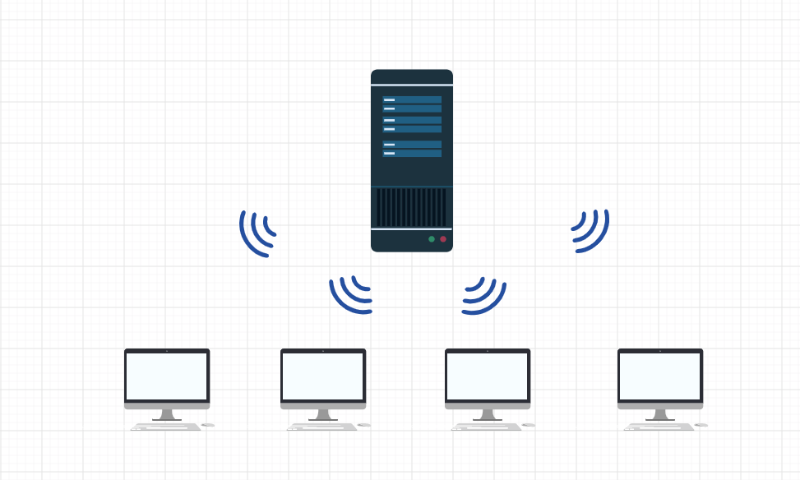
WX Server Controls 4 Monitors

Slide 19
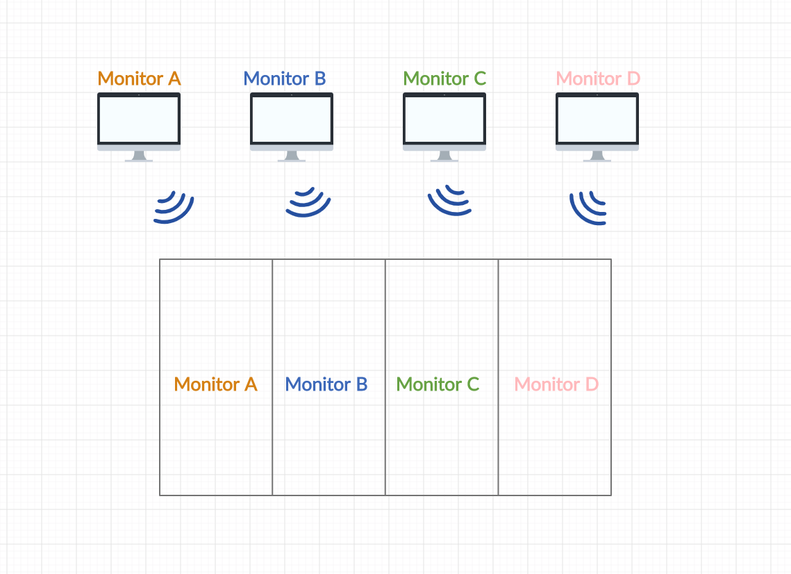
Starting Mode

Slide 20
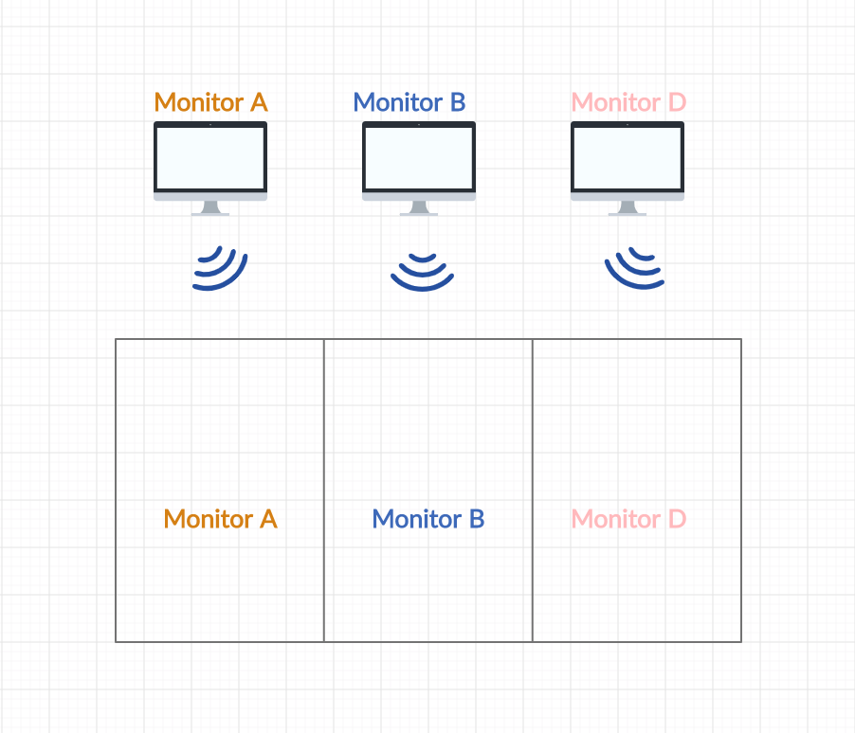
Monitor C - Crashed

Slide 21
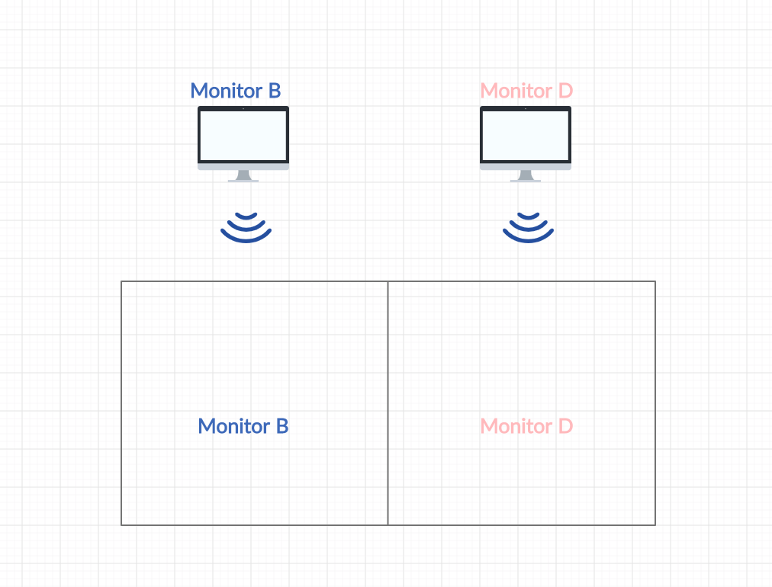
Monitor A - Crashed

Slide 22
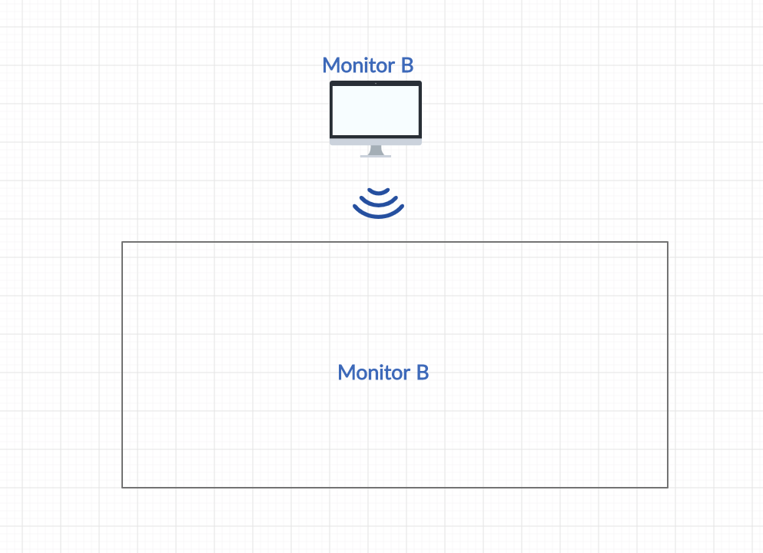
Monitor D - Crashed

Slide 23
Monitor D - Re Established Connection

Slide 24
Main Components - FSM

Slide 25
Player
Moves according to its team strategy.
When owning the ball the player would try to move forward to the rival team’s net and to kick the ball to the direction of the net.
The player’s kick destination is randomized.

Slide 26

Computer Player’s FSM
Player’s architecture
Switch monitor
Switch monitor
idle
Moving (in next monitor)
Random new destination
kick ball
With ball
moving
moving
Assign ball to player
Move toward destin
Update ball coordinates
Update coordinates
Arrived Destination
Near ball
FiFA | Erlang Final Project

Slide 27
Events table - Computer Player
State | Event | Condition | Action | Next State
Wait For Start Game | Mouse click | - | Component init | idle
idle | Enter state | - | Random new destination | moving
moving | Move to next location | Location /= destination | Update next location in monitor | moving
moving | Move to next location | Ball is Near | Update ball to move with player | moving
moving | kick | Player with ball | Set destination for ball | moving
moving | Move to next location | Arrive Destination | Exit state | idle
moving | Move to next location | Crossed monitor borders | Switch monitor | Moving (in next monitor)

Slide 28
Controlled Player’s FSM
Player’s architecture
Switch monitor
Switch monitor
idle
Moving (in next monitor)
Wait for wxMouse
kick ball
With ball
movement
Assign ball to player
Move with
Mouse coordinates
wxMouse left_up click
Update coordinates
Mouse stopped
Near ball
FiFA | Erlang Final Project

Slide 29
Events table
State | Event | Condition | Action | Next State
Wait For Start Game | wxMouse click | - | Component init | idle
idle | Enter state | - | Wait for wxMouse | moving
moving | wxMouse moved | - | Update next location in monitor | idle
moving | wxMouse moved | Ball is Near | Update ball to move with player | idle
moving | wxMouse left_up click | Player with ball | Set destination for ball | idle
moving | wxMouse moved | Crossed monitor borders | Switch monitor | Moving (in next monitor)

Slide 30
Ball
The ball is implemented by FSM - using gen_statem.
If the ball coordinates are inside the net then the relevant group gains a point.
The ball location is set according to the location of the player that posses it.

Slide 31
Ball FSM
Ball’s architecture
Switch monitor
Switch monitor
Attached to Player
Moving (in next monitor)
idle
move
wait
Update Ball
coordinates
Kick (not goal)
goal
Received Kick
Finish round (reset)
Update team’s score
FiFA | Erlang Final Project

Slide 32
Events table
State | Event | Condition | Action | Next State
Wait For Start Game | wxMouse click | - | Component init | idle
idle | Enter state | Attached to player | Update new Coordinations | idle
moving | kicked | - | Set new destination | moving
moving | Moved to next location | Location /= destination | Set next location toward destination | moving
moving | Moved to next location | Player is near | Attached to player | idle
moving | Moved to next location | Location == destination | Check if goal | Finish round(goal) / idle (not goal)
moving | Move to next location | Crossed monitor borders | Switch monitor | Moving (in next monitor)

Slide 33
Statistics

Slide 34
statistics
The game also support in statistics on the game and on the players, the following statistics are monitored and shown in the end of each round and at the end of the game:
Each time points.
The total number of ball possessions.
The number of ball possessions of each team.
The number of ball possessions of each player.
These statistics are maintained by the ETS (DB) and resilient to servers crash as these ETS are maintained by the WX server.

Slide 35
Snapshots

Slide 36
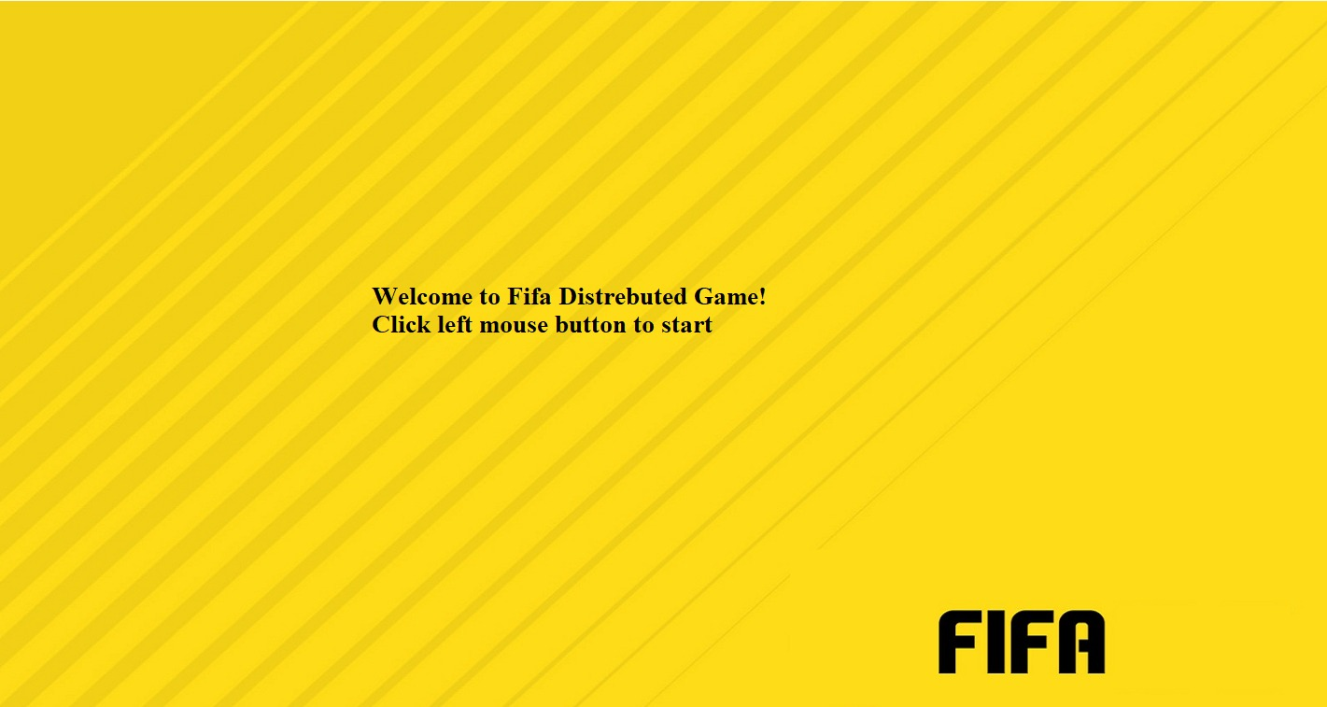
Opening Screen

Slide 37
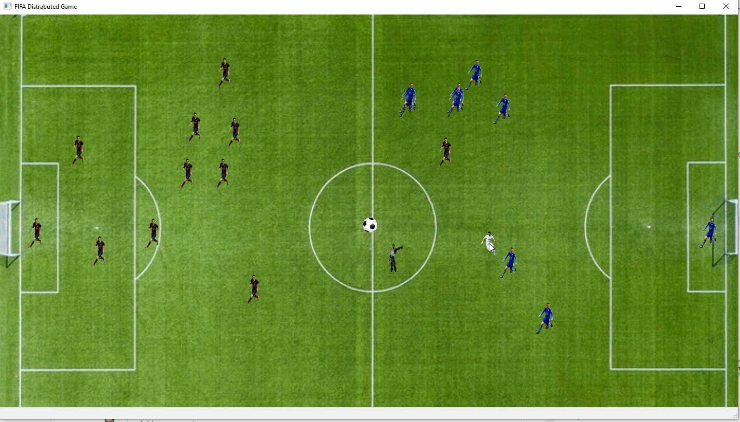
Game Screen

Slide 38
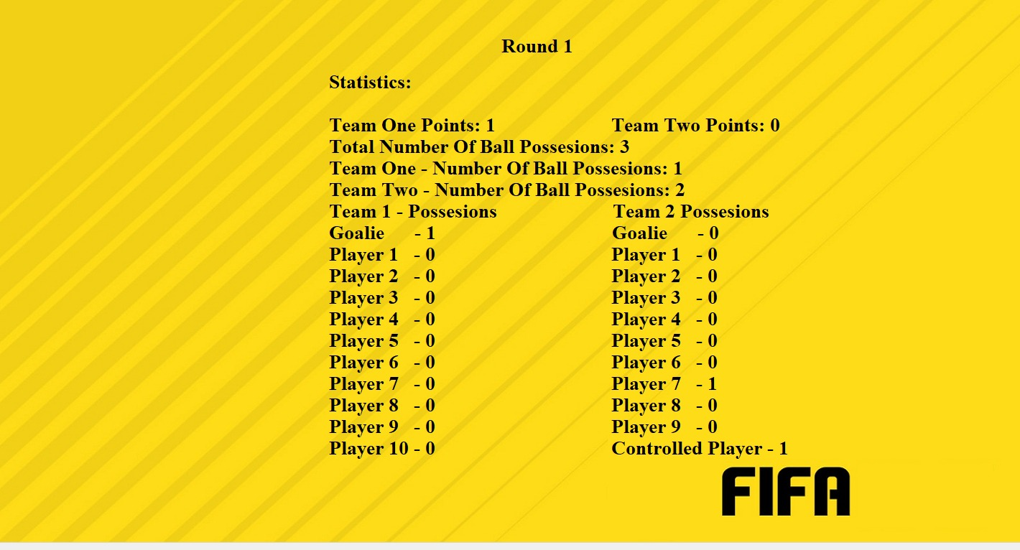
Statistics Screen - at the end of each round

Slide 39
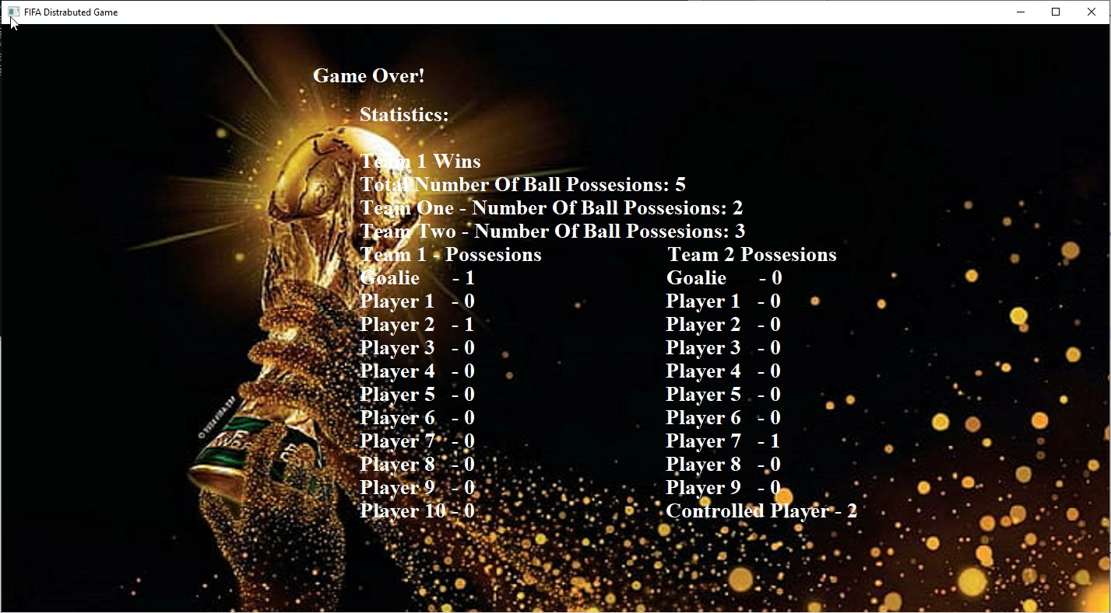
Game Over Screen

Slide 40
Project Overview

Slide 41
Difficulties along the project
Understanding the WxWidget.
Implement the async communication between the servers - using `gen_server`.
Distribute the game over 4 monitors (split screens).
Trying to implement a complex game with a lot of logic and components that work in parallel.

Slide 42
Let’s Talk Code
An exciting fact about the code is that it is very concise and short in contrast to its vast functionalities. In a non-functional language the code length would probably have been at least doubled.
Pattern matching is functionality that Erlang enables to make the code more efficiently and concisely.
Recursions is a strong tool that can be commonly used in functional programming.
WX interface is full of options and enabled us to add graphics to the game without having a lot of knowledge in the UI world.
Using gen_server behavior is an easy way to manage async communication.
Using gen_statem behavior to implement FSM.

Slide 43
Conclusions
Scalability should be taken care of in the planning stage.
ETS is a good source for sharing data between processes.
It is critical to plan the gen_server and gen_statem prior to the coding phase.

Slide 44
TimeLine
16/06/2020
JUL
Coding
Testing
October
21/10/2020
Design Presentation
Final Design
Code and Debug
Testing Beta Product On one computer -
5 Terminals
Test Product On 5 Computers
Project Presentation

Slide 45
Links
User Manual
Youtube Video
GitHub Repository

Slide 46
Questions?

